Slide 1
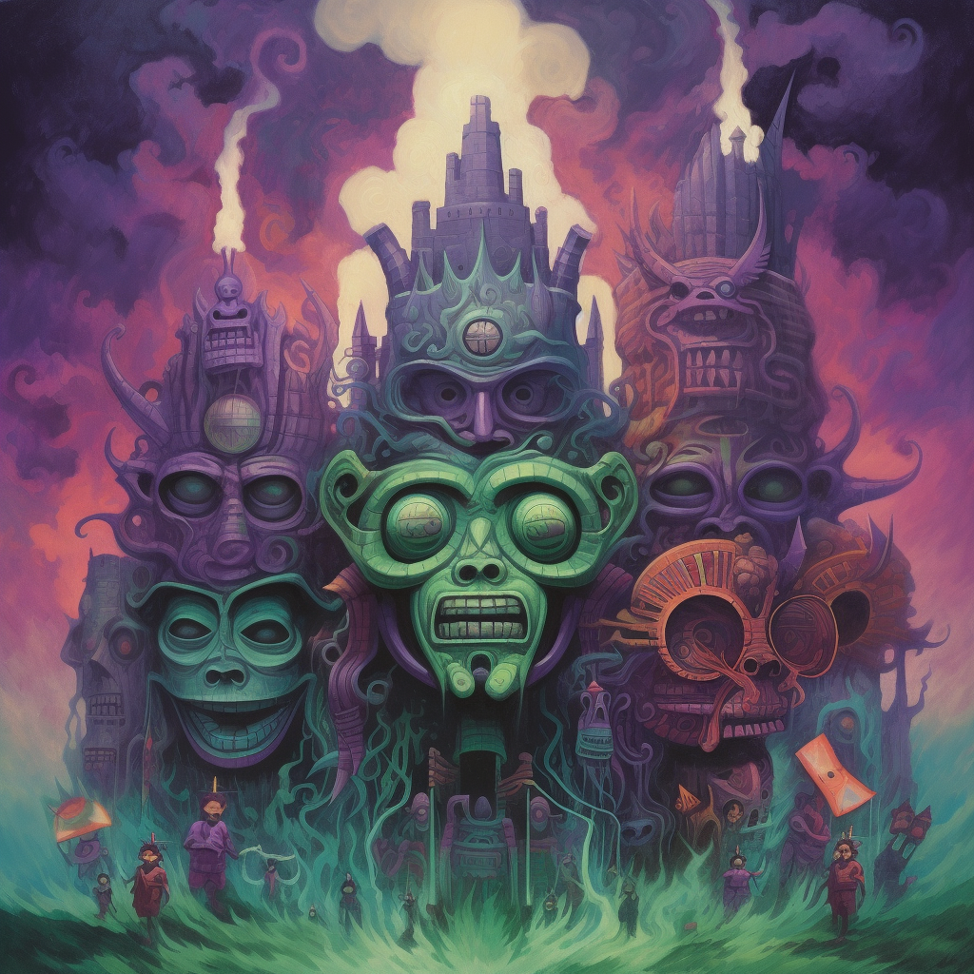
INCURSION
TRAILER BRIEF

Slide 2
A series of broken African tribal masks flashing rapidly
We are Free
We failed

Slide 3
A series of images of the girl meditating flashing rapidly
The last image should be one of the more disturbing shots
Control Yourself
CLOSER
Don’t give In
CLOSER

Slide 4
Embrace it
RUN
Free yourself
RUN
ALTERNATE BETWEEN SCARY AND CALM

Slide 5
IT KNOWS YOUR NAME
MINE
SPLASH SCREEN WITH THE TITLE ANIMATED

